Slide 1
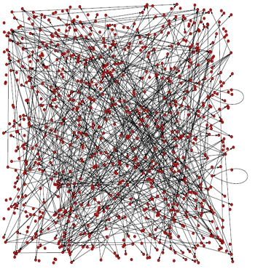
L7. Bayesian Network
(Modeling)
Probability + Statistics + Graph Theory

Slide 2

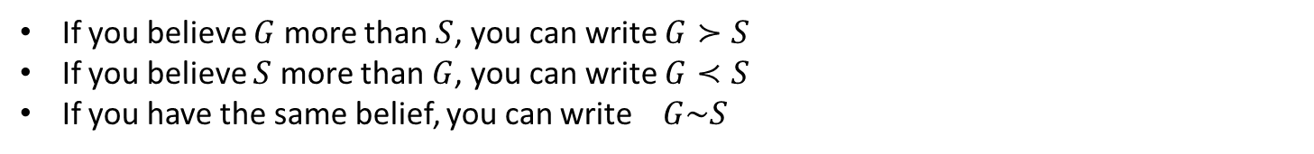
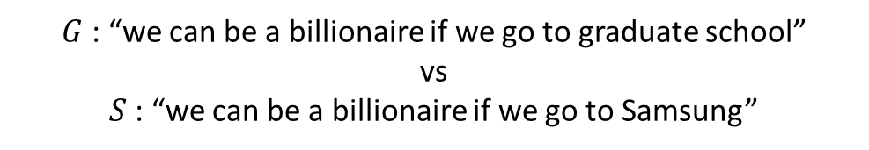
Degree of Belief and Probability
How to compare the plausibility of different statements?
$G$: “we can be a billionaire if we go to graduate school”
vs
$S$: “we can be a billionaire if we go to Samsung”
If you believe $G$ more than $S$, you can write $G≻S$
If you believe $S$ more than $G$, you can write $G≺S$
If you have the same belief, you can write $G\sim S$
Assumptions about relationships of $≻$ and $\sim$
Universal comparability : either $G≻S$, $G≺S$ or $G\sim S$
Transitivity : if $G≻S$ and $S≻V$, then $G≻V$
Due to the two assumptions, the degree of belief can be represented by a real-valued function:
$P\left(G\right)>P\left(S\right)$ if and only if $G≻V$
$P\left(G\right)=P\left(S\right)$ if and only if $G\sim V$

Slide 3
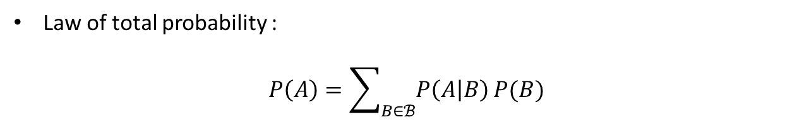
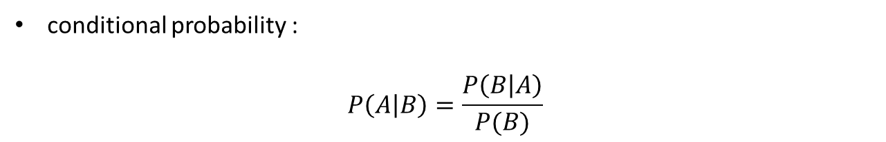
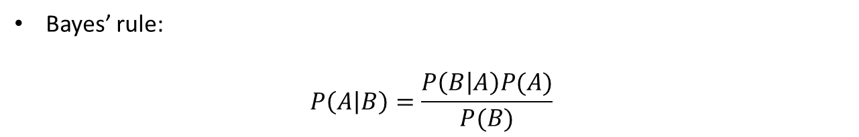
Properties of probabilities for Bayesian Networks
We are going to use very simple probability theories to construct Probabilistic Graphical Model
conditional probability :
$$P\left(A | B\right)=\frac{P\left(B | A\right)}{P(B)}$$
Law of total probability :
$$P\left(A\right)=\sum_{B∈ℬ}^{ }{P\left(A | B\right)}P(B)$$
Bayes’ rule:
$$P\left(A | B\right)=\frac{P\left(B | A\right)P(A)}{P(B)}$$

Slide 4




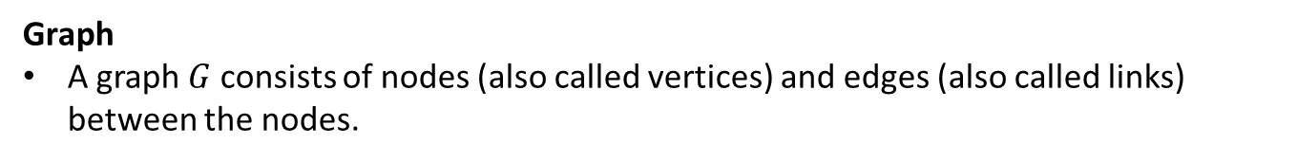






Introduction to Graph Theory
Graph
A graph $G$ consists of nodes (also called vertices) and edges (also called links) between the nodes.
$$A$$
$$B$$
$$E$$
A directed graph $G$ consists of directed edges between nodes
$$D$$
$$C$$
$$A$$
$$B$$
$$E$$
An undirected graph $G$ consists of undirected edges between nodes
$$D$$
$$C$$

Slide 5


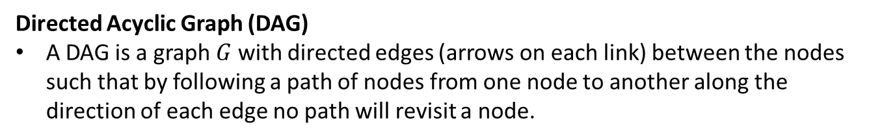



Introduction to Graph Theory
Directed Acyclic Graph (DAG)
A DAG is a graph $G$ with directed edges (arrows on each link) between the nodes such that by following a path of nodes from one node to another along the direction of each edge no path will revisit a node.
Cyclic Graph
Acyclic Graph
$$A$$
$$A$$
$$B$$
$$C$$
$$B$$
$$C$$
DAG will play a central role in modeling environments with many variables
→ will be used for the belief networks
→ can encode the direction dependence between the parent nodes and child nodes.

Slide 6

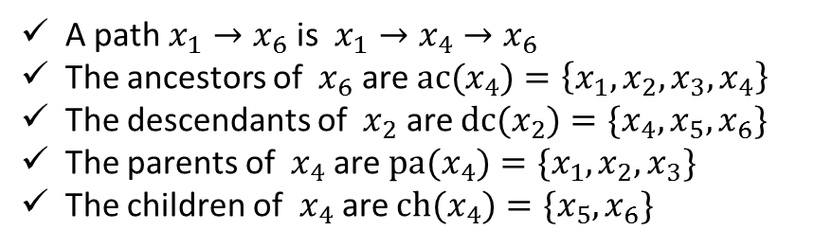




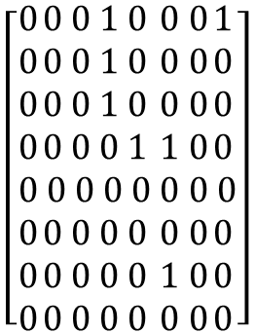



Introduction to Graph Theory
Path
A path $A→B$ from node $A$ to node $B$ is a sequence of nodes that connects $A$ to $B$
Ancestors
In directed graph, the nodes $A$ such that $A→B$ and $B↛A$ are the ancestors of $B$
Descendants
In directed graph, the nodes $B$ such that $A→B$ and $B↛A$ are the descendants of $A$
$$x_{1}$$
$${ x}_{2}$$
$${ x}_{3}$$
Representations
Edge list
$$L=\left\{\left(x_{1},x_{4}\right),\left(x_{2},x_{4}\right),\left(x_{3},x_{4}\right),\left(x_{1},x_{8}\right),\left(x_{4},x_{5}\right),\left(x_{4},x_{6}\right),\left(x_{7},x_{6}\right)\right\}$$
$${ x}_{8}$$
$${ x}_{4}$$
$${ x}_{7}$$
Adjacency matrix
$$\left[\begin{aligned}0 \\ 0 \\ 0 \\ 0 \\ 0 \\ 0 \\ 0 \\ 0\end{aligned}\begin{aligned}0 \\ 0 \\ 0 \\ 0 \\ 0 \\ 0 \\ 0 \\ 0\end{aligned}\begin{aligned}0 \\ 0 \\ 0 \\ 0 \\ 0 \\ 0 \\ 0 \\ 0\end{aligned}\begin{aligned}1 \\ 1 \\ 1 \\ 0 \\ 0 \\ 0 \\ 0 \\ 0\end{aligned}\begin{aligned}0 \\ 0 \\ 0 \\ 1 \\ 0 \\ 0 \\ 0 \\ 0\end{aligned}\begin{aligned}0 \\ 0 \\ 0 \\ 1 \\ 0 \\ 0 \\ 1 \\ 0\end{aligned}\begin{aligned}0 \\ 0 \\ 0 \\ 0 \\ 0 \\ 0 \\ 0 \\ 0\end{aligned}\begin{aligned}1 \\ 0 \\ 0 \\ 0 \\ 0 \\ 0 \\ 0 \\ 0\end{aligned}\right]$$
$${ x}_{5}$$
$${ x}_{6}$$
A path $x_{1}→x_{6}$ is $x_{1}→x_{4}→x_{6}$
The ancestors of ${ x}_{6}$ are ${ac(x}_{4})=\left\{x_{1},x_{2},x_{3},x_{4}\right\}$
The descendants of ${ x}_{2}$ are ${dc(x}_{2})=\{x_{4},x_{5},x_{6}\}$
The parents of ${ x}_{4}$ are ${pa(x}_{4})=\{x_{1},x_{2},x_{3}\}$
The children of ${ x}_{4}$ are ${ch(x}_{4})=\{x_{5},x_{6}\}$

Slide 7
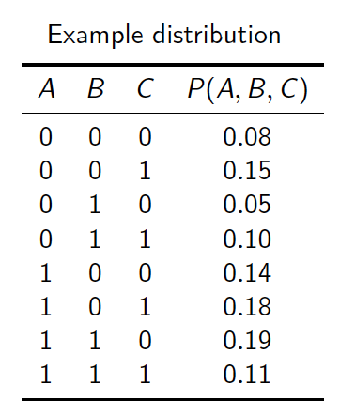
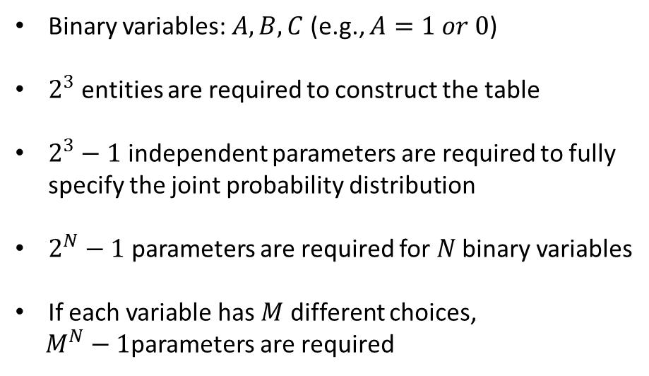
Motivation of Bayesian Network
Full Joint Distribution
Binary variables: $A, B, C$ (e.g., $A=1 or 0$)
$2^{3}$ entities are required to construct the table
$2^{3}−1$ independent parameters are required to fully specify the joint probability distribution
$2^{N}−1$ parameters are required for $N$ binary variables
If each variable has $M$ different choices,
$M^{N}−1$parameters are required
The number of parameters grows exponentially
→ Difficult to represent Probability distribution and learn the parameters from data

Slide 8


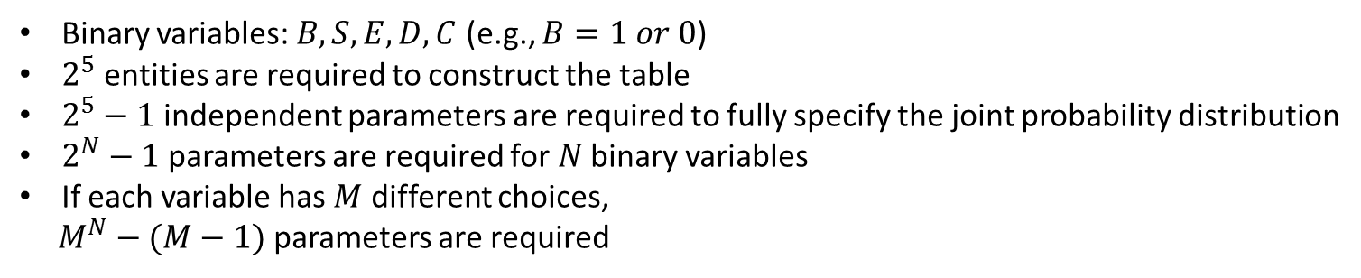



Motivation of Bayesian Network
Full Joint Probability Distribution
Battery failure
$$B$$
$$S$$
Solar panel failure
$$E$$
Electrical system failure
Trajectory deviation
$$D$$
$$C$$
Communication loss
Binary variables: $B, S, E,D,C$ (e.g., $B=1 or 0$)
$2^{5}$ entities are required to construct the table
$2^{5}−1$ independent parameters are required to fully specify the joint probability distribution
$2^{N}−1$ parameters are required for $N$ binary variables
If each variable has $M$ different choices,
$M^{N}−(M−1)$ parameters are required
The number of parameters grows exponentially
→ Difficult to represent Probability distribution and learn the parameters from data

Slide 9
Motivation of Bayesian Network
A Bayesian network is a compact representation of a joint distribution
Battery failure
$$B$$
$$S$$
Solar panel failure
$$E$$
Electrical system failure
Trajectory deviation
$$D$$
$$C$$
Communication loss
Probability + Statistics + Graph Theory
A Bayesian Network introduces structure into a probabilistic model by using graphs to represent independence assumptions among the variables. For inferencing, it use statistics
Provide a good representation to model the probabilistic structures between random variables.
Nodes represent random variables
Edges represent probabilistic dependency, namely conditional probability among variables
Conditional independence described by the graph, greatly reduce the computational effort to learn the model and inferencing random variables.

Slide 10
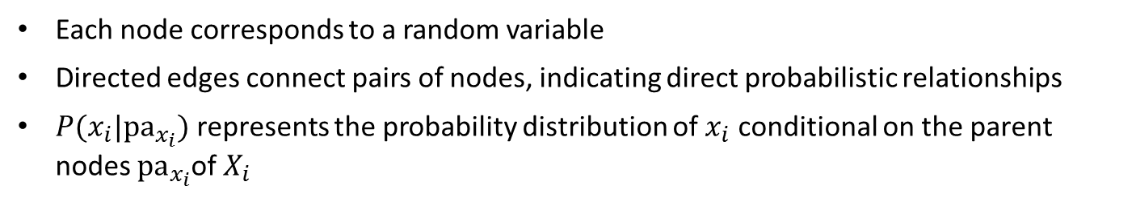
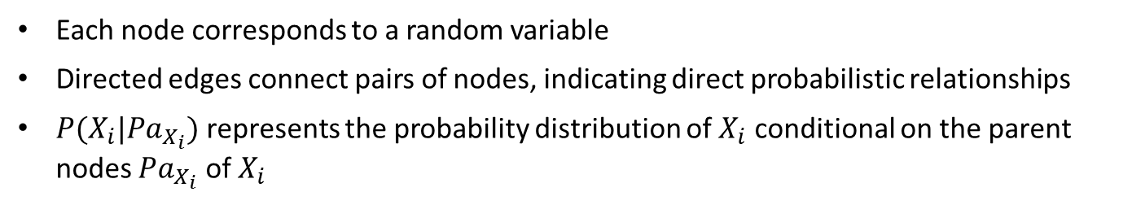
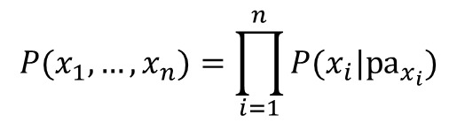
Motivation of Bayesian Network
A Bayesian network is a compact representation of a joint distribution
Battery failure
$$B$$
$$S$$
Solar panel failure
$$E$$
Electrical system failure
Trajectory deviation
$$D$$
$$C$$
Communication loss
Each node corresponds to a random variable
Directed edges connect pairs of nodes, indicating direct probabilistic relationships
$P(x_{i}|{pa}_{x_{i}})$ represents the probability distribution of $x_{i}$ conditional on the parent nodes ${pa}_{x_{i}}$of $X_{i}$
e.g., $P(E|B, S)$ : $B and S$ are the parent nodes of $E$
The chain rule for Bayesian networks specifies how to construct a joint distribution from the local conditional probability distribution
$$P(x_{1},…,x_{n})=\prod_{i=1}^{n}{P(x_{i}|{pa}_{x_{i}})}$$
local conditional probability distribution

Slide 11

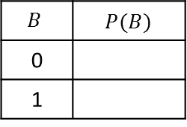


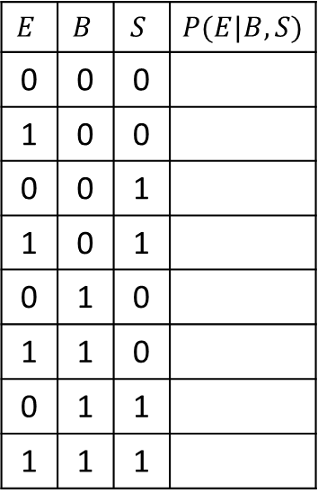


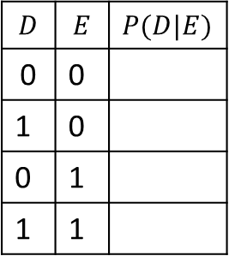
Motivation of Bayesian Network
A Bayesian network is a compact representation of a joint distribution
$$B$$ | $P(B)$
0
1
$$B$$
$$S$$
$$E$$ | $$B$$ | $$S$$ | $P(E|B, S)$
0 | 0 | 0
1 | 0 | 0
0 | 0 | 1
1 | 0 | 1
0 | 1 | 0
1 | 1 | 0
0 | 1 | 1
1 | 1 | 1
$P(B)$
$P(S)$
$$E$$
$P(E|B, S)$
$$D$$ | $$E$$ | $P(D|E)$
0 | 0
1 | 0
0 | 1
1 | 1
$P(D|E)$
$$D$$
$$C$$
$P(C|E)$
Chain rule: $P\left(B, S, E, D, C\right)=P\left(B\right)P\left(S\right)P\left(E | B,S\right)P\left(D | E\right)P(C|E)$
Required independent parameters to fully specify the joint PDF
$P(B)$ : 1, $P(S)$ : 1, $P(E|B,S)$ : 4, $P(D|E)$ : 2, $P(C|E)$ : 2 (total 10 compared to $2^{5}$-1 = 31)
Bayesian network can greatly reduce the number of parameters

Slide 12
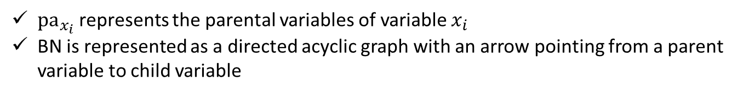
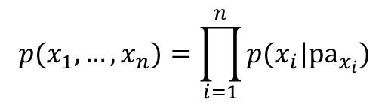
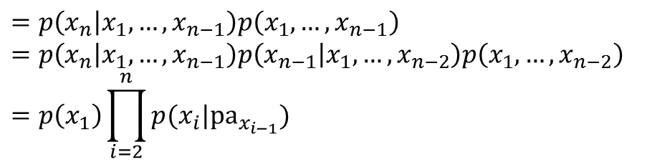

Formal Definition Bayesian Network
A Bayesian network (BN) is a distribution of the form
$$p(x_{1},…,x_{n})=\prod_{i=1}^{n}{p(x_{i}|{pa}_{x_{i}})}$$
${pa}_{x_{i}}$ represents the parental variables of variable $x_{i}$
BN is represented as a directed acyclic graph with an arrow pointing from a parent variable to child variable
Every probability distribution can be written as a BN:
$$p(x_{1},…,x_{n})$$
$$=p\left(x_{n} | x_{1},…,x_{n−1}\right)p\left(x_{1},…,x_{n−1}\right)$$
$$=p\left(x_{n} | x_{1},…,x_{n−1}\right)p\left(x_{n−1} | x_{1},…,x_{n−2}\right)p\left(x_{1},…,x_{n−2}\right)$$
$$=p\left(x_{1}\right)\prod_{i=2}^{n}{p(x_{i}|{pa}_{x_{i−1}})}$$
The particular role of BN is that the structure of the DAG corresponds to a set of conditional independence assumptions, namely which ancestral parental variables are sufficient to specify each conditional probability table

Slide 13

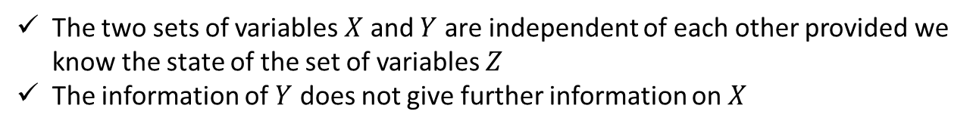




Conditional Independence
Definition : Independence
$$X⊥Y$$
$p(X,Y)=p(X)p(Y)$ for all states of $X$, $Y$
or equivalently $P\left(X | Y\right)=P(X)$
Definition : Conditional Independence
$$X⊥Y|Z$$
$p\left(X,Y | Z\right)=p\left(X | Z\right)p(Y|Z)$ for all states of $X$, $Y$, $Z$
or equivalently $P\left(X | Y, Z\right)=P(X|Z)$
The two sets of variables $X$ and $Y$ are independent of each other provided we know the state of the set of variables $Z$
The information of $Y$ does not give further information on $X$

Slide 14






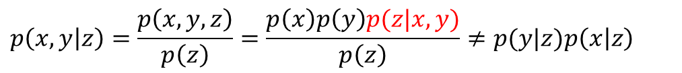

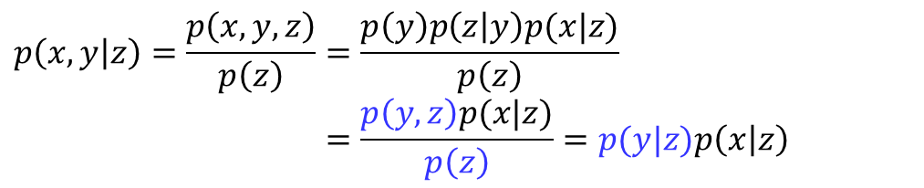





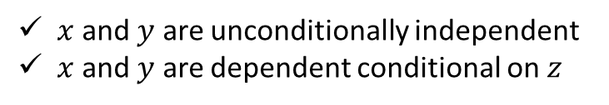


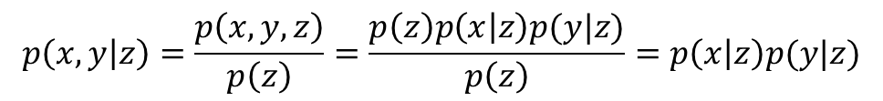
V-structure (or collider)
$$x$$
$$y$$
$$p\left(x,y | z\right)=\frac{p\left(x,y,z\right)}{p\left(z\right)}=\frac{p\left(z\right)p\left(x | z\right)p(y|z)}{p\left(z\right)}=p\left(x | z\right)p(y|z)$$
$$z$$
$$x$$
$$y$$
$$p\left(x,y | z\right)=\frac{p\left(x,y,z\right)}{p\left(z\right)}=\frac{p\left(x\right)p\left(z | x\right)p(y|z)}{p\left(z\right)}$$
$$=\frac{p\left(x,z\right)p(y|z)}{p\left(z\right)}=p\left(x | z\right)p(y|z)$$
$$z$$
$$x$$
$$y$$
$$p\left(x,y | z\right)=\frac{p\left(x,y,z\right)}{p\left(z\right)}=\frac{p\left(y\right)p\left(z | y\right)p(x|z)}{p\left(z\right)}$$
$$=\frac{p\left(y,z\right)p(x|z)}{p\left(z\right)}=p(y|z)p\left(x | z\right)$$
$$z$$
$$x$$
$$y$$
$$p\left(x,y | z\right)=\frac{p\left(x,y,z\right)}{p\left(z\right)}=\frac{p\left(x\right)p\left(y\right)p(z|x,y)}{p\left(z\right)}≠p(y|z)p\left(x | z\right)$$
$$z$$
BN with $x→z←y$
$x$ and $y$ are unconditionally independent
$x$ and $y$ are dependent conditional on $z$

Slide 15




























V-structure (or collider)
$$p\left(x,y,z\right)=p\left(x|z\right)p(y|z)$$
$$p\left(x,y,z\right)=p\left(z | x,y\right)p\left(x\right)p(y)$$
$$x$$
$$y$$
$$x$$
$$y$$
$$z$$
$$z$$
Marginalization over z
Marginalization over z
$$x$$
$$y$$
$$x$$
$$y$$
$$x$$
$$y$$
$$x$$
$$y$$
$$z$$
$$z$$
Conditionalization on z
Conditionalization on z
$$x$$
$$y$$
$$x$$
$$y$$
$$x$$
$$y$$
$$x$$
$$y$$
$$z$$
$$z$$

Slide 16




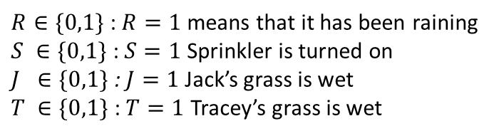




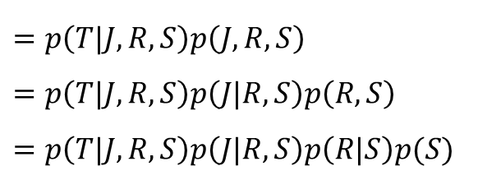





Example : Wet Grass
$$S$$
$$R$$
$R∈\{0,1\}$ : $R=1$ means that it has been raining
$S ∈\{0,1\}$ : $S=1$ Sprinkler is turned on
$J ∈\{0,1\}$ : $J=1$ Jack’s grass is wet
$T ∈\{0,1\}$ : $T=1$ Tracey’s grass is wet
$$T$$
$$J$$
Joint distribution based on chain rule
$$p\left(T,J,R,S\right)$$
$$=p\left(T|J,R,S\right)p\left(J,R,S\right)$$
$$=p\left(T|J,R,S\right)p\left(J|R,S\right)p\left(R,S\right)$$
$$=p\left(T|J,R,S\right)p\left(J|R,S\right)p\left(R|S\right)p(S)$$
$8+ 4+ 2+ 1 = 2^{4}−1=15$parameters are required
Joint distribution conditional independence
$$p\left(T,J,R,S\right)=p\left(T|J,R,S\right)p\left(J|R,S\right)p\left(R|S\right)p(S)$$
$$=p\left(T|R,S\right)$$
$$p\left(J|R\right)$$
$$p\left(R\right)$$
$$p(S)$$
$$×$$
$$×$$
$$×$$
$$=p\left(T|R,S\right)p\left(J|R\right)p\left(R\right)p(S)$$

Slide 17




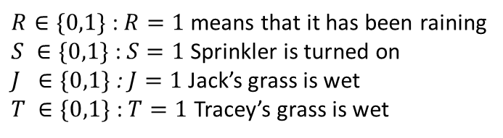





Example : Wet Grass
Modeling
$$S$$
$$R$$
$R∈\{0,1\}$ : $R=1$ means that it has been raining
$S ∈\{0,1\}$ : $S=1$ Sprinkler is turned on
$J ∈\{0,1\}$ : $J=1$ Jack’s grass is wet
$T ∈\{0,1\}$ : $T=1$ Tracey’s grass is wet
$$T$$
$$J$$
$$p\left(T,J,R,S\right)=p\left(T|R,S\right)p\left(J|R\right)p\left(R\right)p(S)$$
$$p\left(T|S,E\right)$$
$$p\left(J|R\right)$$
$$p\left(S=1\right)=0.1$$
Tracey’s Grass wet=1 | Rain | Sprinkler
1 | 1 | 1
1 | 1 | 0
0.9 | 0 | 1
0 | 0 | 0
Jack’s Grass wet=1 | Rain
1 | 1
0.2 | 0
$$p\left(R=1\right)=0.2$$
The tables and graphical structure fully specify the distribution

Slide 18
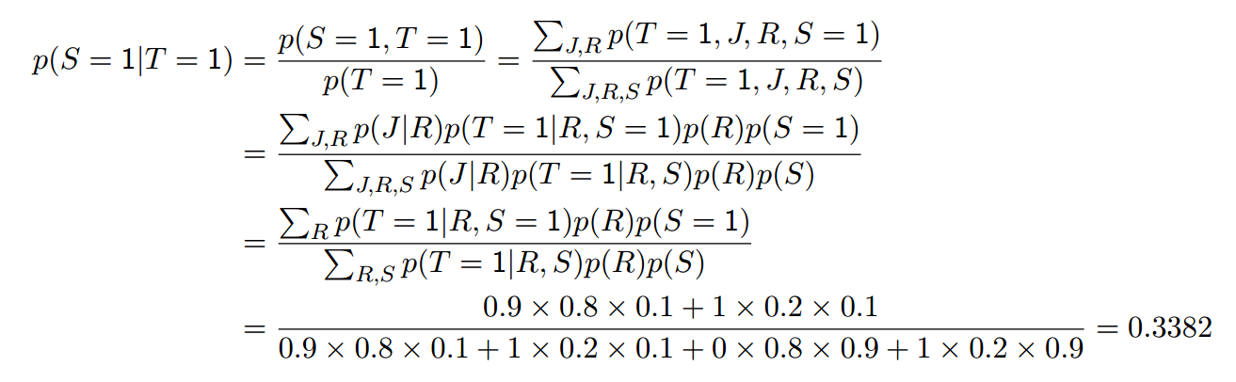
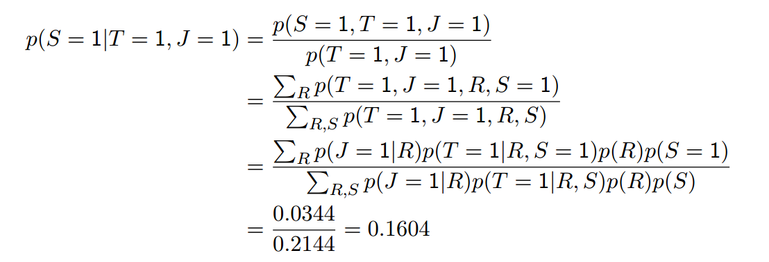
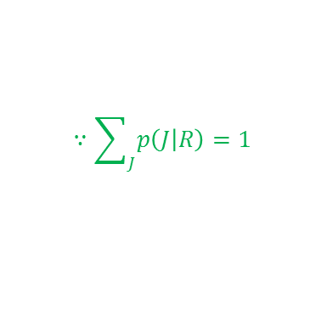
Example : Wet Grass
Inference
$$∵\sum_{J}^{ }{p\left(J | R\right)=1}$$
The fact that Jack’s grass is also wet increases the chance that the rain has played a role in making Tracey’s grass wet

Slide 19




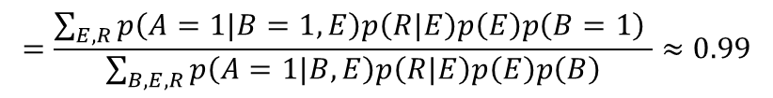

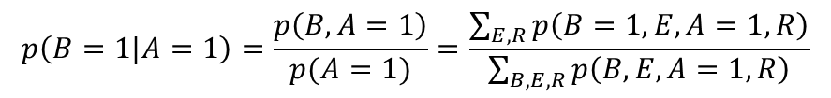




Example : Burglar Alarm
$$B$$
$$E$$
Has been burgled
Earth quake
Burglar alarm
$$A$$
$$R$$
Radio broadcast for earth quake
$$p\left(B,E, A,R\right)=p\left(A|B,E\right)p\left(R|E\right)p\left(E\right)p\left(B\right)$$
$$p\left(A|B,E\right)$$
$$p\left(R|E\right)$$
$$p\left(E=1\right)=0.01$$
Alarm=1 | Burglar | Earthquake
0.9999 | 1 | 1
0.99 | 1 | 0
0.99 | 0 | 1
0.0001 | 0 | 0
Radio=1 | Earthquake
1 | 1
0 | 0
$$p\left(E=1\right)=0.000001$$
$$p\left(B=1|A=1\right)=\frac{p\left(B,A=1\right)}{p(A=1)}=\frac{\sum_{E,R}^{ }{p\left(B=1,E,A=1,R\right)}}{\sum_{B,E,R}^{ }{p\left(B,E,A=1,R\right)}}$$
$$=\frac{\sum_{E,R}^{ }{p\left(A=1|B=1,E\right)p\left(R|E\right)p\left(E\right)p\left(B=1\right) }}{\sum_{B,E,R}^{ }{p\left(A=1|B,E\right)p\left(R|E\right)p\left(E\right)p\left(B\right)}}≈0.99$$
$$p\left(B=1|A=1,R=1\right)≈0.01$$

Slide 20
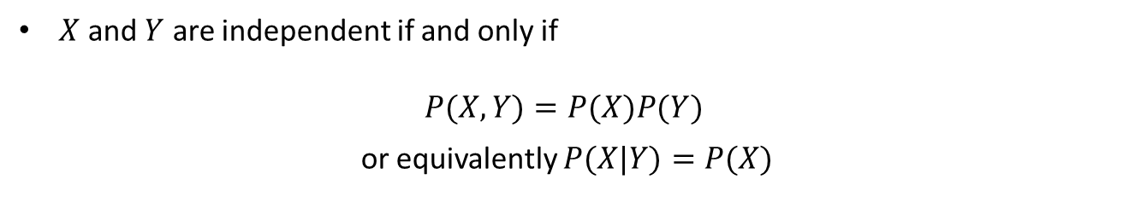

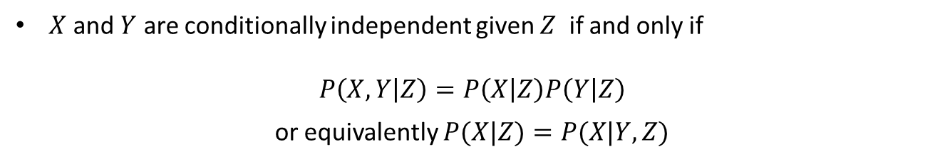
Conditional Independence
Where causes the number of parameters to be reduced?
→ The conditional independence assumptions encoded by the structure of a Bayesian network
$X$ and $Y$ are independent if and only if
$$P(X, Y)=P(X)P(Y)$$
or equivalently $P(X|Y)=P(X)$
$$∵P\left(X | Y\right)=\frac{P\left(X,Y\right)}{P\left(Y\right)}=\frac{P(X)P(Y)}{P\left(Y\right)}=P(X)$$
$X$ and $Y$ are conditionally independent given $Z$ if and only if
$$P\left(X, Y | Z\right)=P\left(X | Z\right)P\left(Y | Z\right)$$
or equivalently $P(X|Z)=P(X|Y, Z)$
Independence assumptions reduce the number of parameters used to represent a joint pdf

Slide 21
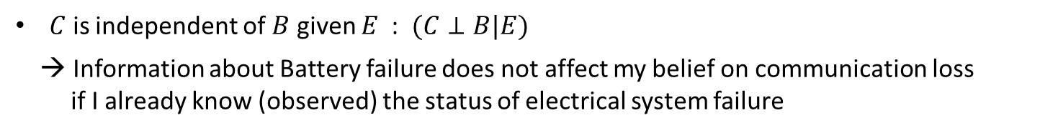





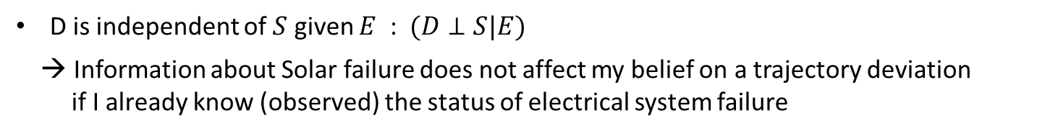
Conditional Independence examples
Battery failure
$$B$$
$$S$$
Solar panel failure
$$E$$
Electrical system failure
Trajectory deviation
$$D$$
$$C$$
Communication loss
$C$ is independent of $B$ given $E$ : $(C⊥B|E)$
→ Information about Battery failure does not affect my belief on communication loss
if I already know (observed) the status of electrical system failure
D is independent of $S$ given $E$ : $(D⊥S|E)$
→ Information about Solar failure does not affect my belief on a trajectory deviation
if I already know (observed) the status of electrical system failure

Slide 22
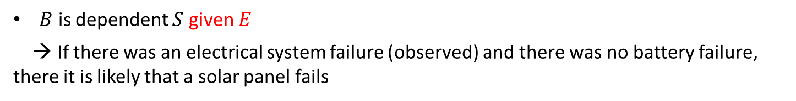
Conditional Independence examples
V-structure
Battery failure
$$B$$
$$S$$
Solar panel failure
$$E$$
Electrical system failure
Trajectory deviation
$$D$$
$$C$$
Communication loss
$B$ is independent $S$ ($E$ is not observed)
→ Knowing there is a battery failure does not affect my belief regarding solar panel failure
$B$ is dependent $S$ given $E$
→ If there was an electrical system failure (observed) and there was no battery failure, there it is likely that a solar panel fails
Influence flows only through $B→ E←S$ when $E$ is known

Slide 23
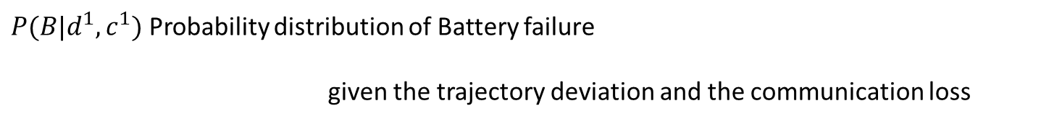







Inference
Once a joint probability distribution is constructed, inference can be performed to determine the distribution over on or more unobserved variables given the values associated with a set of observed variables
Battery failure
$$B$$
$$S$$
Solar panel failure
$$E$$
Electrical system failure
Trajectory deviation
$$D$$
$$C$$
Communication loss
$P(B|d^{1}, c^{1})$ Probability distribution of Battery failure
given the trajectory deviation and the communication loss
Query variable
Evidence variable
$$E$$
$$S$$
: Hidden variables

Slide 24

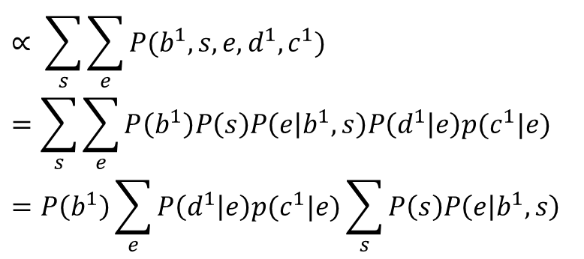

Inference
How to compute $P(B|d^{1}, c^{1})$?
Exact inference
$$∝ \sum_{s}^{ }{\sum_{e}^{ }{P(b^{1}, s, e, d^{1}, c^{1})}}$$
$$=\sum_{s}^{ }{\sum_{e}^{ }{P\left(b^{1}\right)P\left(s\right)P\left(e | b^{1}, s\right)P\left(d^{1} | e\right)p(c^{1}|e)}}$$
$$=P\left(b^{1}\right)\sum_{e}^{ }{P\left(d^{1} | e\right)p(c^{1}|e)\sum_{s}{P\left(s\right)P\left(e | b^{1}, s\right)}}$$
$$P\left(b^{1} | d^{1}, c^{1}\right)$$
By conditional independence
The number of terms to be added together can grow exponentially with the number of hidden variables

Slide 25
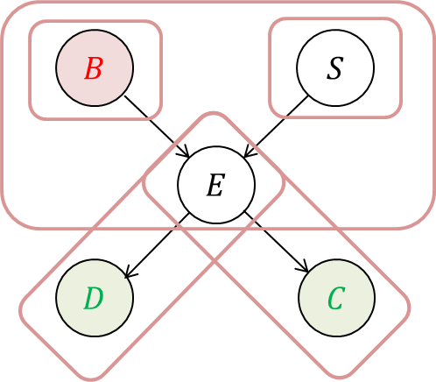




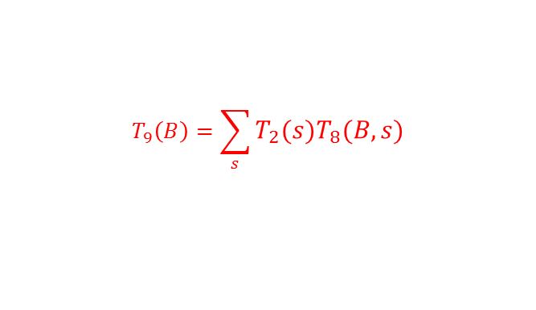

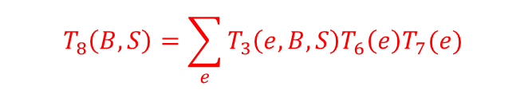
Inference
How to compute $P(B|d^{1}, c^{1})$?
Variable Elimination
Conditional distributions are represented by the following tables
$$T_{1}\left(B\right)T_{2}\left(S\right)T_{3}\left(E, B, S\right)T_{4}\left(d^{1}, E\right)T_{5}(c^{1}, E)$$
$$T_{1}\left(B\right)T_{2}\left(S\right)T_{3}\left(E, B, S\right)T_{6}\left(E\right)T_{7}(E)$$
Observe evidence ($d^{1}$ and $c^{1}$)
$${T_{1}\left(B\right)T_{2}\left(S\right)T}_{8}\left(B, S\right)$$
$$T_{8}\left(B,S\right)=\sum_{e}^{ }{T_{3}\left(e, B, S\right)T_{6}\left(e\right)T_{7}(e) }$$
$${T_{1}\left(B\right)T}_{9}(B)$$
$$T_{9}\left(B\right)=\sum_{s}^{ }{T_{2}\left(s\right)T_{8}(B,s)}$$
Normalizing the product of the two factors ( ${T_{1}\left(B\right) and T}_{9}(B))$ results in $P(B|d^{1}, c^{1})$
Variable elimination algorithm relies on heuristic ordering of variables to eliminate in sequence
→ Often linear but sometimes exponential

Slide 26







Inference
How to compute $P(B|d^{1}, c^{1})$?
Approximate inference (Sampling based methods)
$$B$$
$$S$$
B | S | E | D | C
1
$$E$$
$$D$$
$$C$$
Sample from $P(B)$

Slide 27


Inference
How to compute $P(B|d^{1}, c^{1})$?
Approximate inference (Sampling based methods)
$$B$$
$$S$$
B | S | E | D | C
1 | 1
$$E$$
$$D$$
$$C$$
Sample from $P(S)$

Slide 28


Inference
How to compute $P(B|d^{1}, c^{1})$?
Approximate inference (Sampling based methods)
$$B$$
$$S$$
B | S | E | D | C
1 | 1 | 1
$$E$$
$$D$$
$$C$$
Sample from $P(E|B=1,S=1)$

Slide 29


Inference
How to compute $P(B|d^{1}, c^{1})$?
Approximate inference (Sampling based methods)
$$B$$
$$S$$
B | S | E | D | C
1 | 1 | 1 | 0
$$E$$
$$D$$
$$C$$
Sample from $P(D|E=1)$

Slide 30


Inference
How to compute $P(B|d^{1}, c^{1})$?
Approximate inference (Sampling based methods)
$$B$$
$$S$$
B | S | E | D | C
1 | 1 | 1 | 0 | 0
$$E$$
$$D$$
$$C$$
Sample from $P(C|E=1)$

Slide 31




Inference
How to compute $P(B|d^{1}, c^{1})$?
Approximate inference (Sampling based methods)
B | S | E | D | C
1 | 1 | 1 | 0 | 0
0 | 1 | 0 | 1 | 0
1 | 0 | 1 | 1 | 1
0 | 1 | 0 | 0 | 1
0 | 1 | 1 | 1 | 1
0 | 1 | 0 | 0 | 1
0 | 0 | 0 | 1 | 0
0 | 1 | 1 | 1 | 0
0 | 1 | 0 | 1 | 1
$$B$$
$$S$$
$$E$$
$$D$$
$$C$$
$$P\left(b^{1} | d^{1}, c^{1}\right)=1/3$$
$$P\left(b^{0} | d^{1}, c^{1}\right)=2/3$$
Three cases coincide observations $d^{1}, c^{1}$

Slide 32
Inference
How to compute $P(B|d^{1}, c^{1})$?
Approximate inference (Sampling based methods)
B | S | E | D | C
1 | 1 | 1 | 0 | 0
0 | 1 | 0 | 1 | 0
1 | 0 | 1 | 1 | 1
0 | 1 | 0 | 0 | 1
0 | 1 | 1 | 1 | 1
0 | 1 | 0 | 0 | 1
0 | 0 | 0 | 1 | 0
0 | 1 | 1 | 1 | 0
0 | 1 | 0 | 1 | 1
$$B$$
$$S$$
$$E$$
$$D$$
$$C$$
$$P\left(b^{1} | d^{1}, c^{1}\right)=1/3$$
$$P\left(b^{0} | d^{1}, c^{1}\right)=2/3$$
Three cases coincide observations $d^{1}, c^{1}$
If likelihood of evidence is small, then many samples are required!!

Slide 33
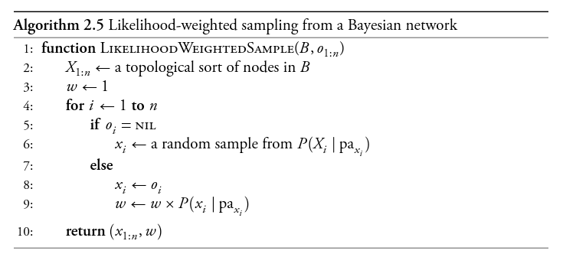
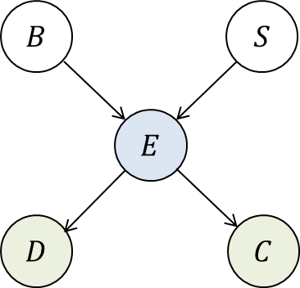
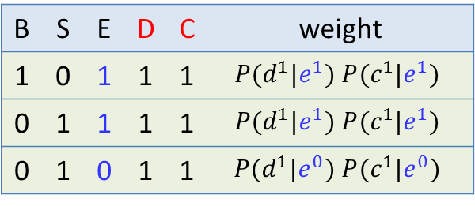
Inference
How to compute $P(B|d^{1}, c^{1})$?
Likelihood sampling
B | S | E | D | C
1 | 1 | 1 | 0 | 0
0 | 1 | 0 | 1 | 0
1 | 0 | 1 | 1 | 1
0 | 1 | 0 | 0 | 1
0 | 1 | 1 | 1 | 1
0 | 1 | 0 | 0 | 1
0 | 0 | 0 | 1 | 0
0 | 1 | 1 | 1 | 0
0 | 1 | 0 | 1 | 1
B | S | E | D | C | weight
1 | 0 | 1 | 1 | 1 | $P(d^{1}|e^{1}) P(c^{1}|e^{1})$
0 | 1 | 1 | 1 | 1 | $P(d^{1}|e^{1}) P(c^{1}|e^{1})$
0 | 1 | 0 | 1 | 1 | $P(d^{1}|e^{0}) P(c^{1}|e^{0})$
$P\left(b^{1} | d^{1}, c^{1}\right)=\frac{P(d^{1}|e^{1}) P(c^{1}|e^{1}) }{P(d^{1}|e^{1}) P(c^{1}|e^{1})+P(d^{1}|e^{1}) P(c^{1}|e^{1})+P(d^{1}|e^{0}) P(c^{1}|e^{0}) }$

Slide 34



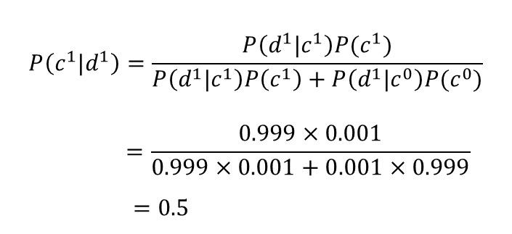


Inference
How to compute $P(B|d^{1}, c^{1})$?
Likelihood sampling has a still problem!
Bayesian approach :
$$C$$
$$P\left(c^{1}\right)=0.001$$
$$P\left(c^{1}|d^{1}\right)=\frac{P\left(d^{1}|c^{1}\right)P(c^{1})}{P\left(d^{1}|c^{1}\right)P\left(c^{1}\right)+P\left(d^{1}|c^{0}\right)P(c^{0})}$$
$$=\frac{0.999×0.001}{0.999×0.001+0.001×0.999}$$
$$=0.5$$
$$P\left(d^{1}|c^{0}\right)=0.001$$
$$D$$
$$P\left(d^{1}|c^{1}\right)=0.999$$
To use likelihood weighting sampling approach:
$c^{0},c^{0},$ $c^{0},c^{0},c^{0},$ $c^{0},$ $c^{0},$ $c^{0},$ $c^{0},$ $c^{0},$ $c^{0},$ $c^{0},$ $c^{0},$ $c^{0},$ $c^{0},…,c^{1}$
$P\left(d^{1}|c^{1}\right)=0$ because $c^{1}$ is not sampled due to the low prior

Slide 35
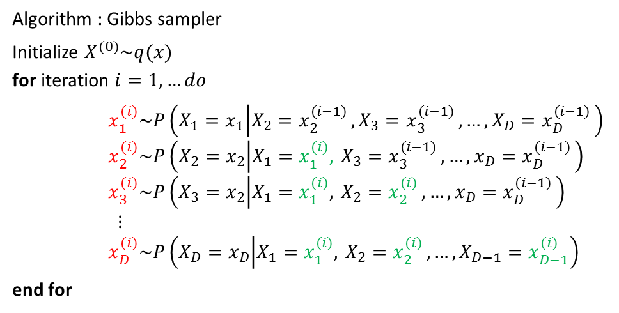
Inference
How to compute $P(B|d^{1}, c^{1})$?
Gibbs sampling, a kind of Markov chain Monte Carlo technique
The sequence of samples forms a Markov chain
In the limit, samples are drawn exactly from the joint distribution over the unobserved variables given the observations
Simulate samples by sweeping through all the posterior conditionals, one random variables at a time
Algorithm : Gibbs sampler
Initialize $X_{ }^{(0)}\sim q(x)$
for iteration $i=1,…do$
$x_{1}^{(i)}\sim P\left(X_{1}=x_{1} | X_{2}=x_{2}^{(i−1) },X_{3}=x_{3}^{(i−1) },…,X_{D}=x_{D}^{(i−1) }\right)$
$x_{2}^{(i)}\sim P\left(X_{2}=x_{2} | {X_{1}=x_{1}^{(i)},}_{ }X_{3}=x_{3}^{(i−1) },…,x_{D}=x_{D}^{(i−1) }\right)$
$x_{3}^{(i)}\sim P\left(X_{3}=x_{2} | {X_{1}=x_{1}^{(i)},}_{ }X_{2}=x_{2}^{(i) },…,x_{D}=x_{D}^{(i−1) }\right)$
⋮
$x_{D}^{(i)}\sim P\left(X_{D}=x_{D} | {X_{1}=x_{1}^{(i)},}_{ }X_{2}=x_{2}^{(i) },…,X_{D−1}=x_{D−1}^{(i) }\right)$
end for
Because samples from the early iterations are not from the target posterior, it is common to discard these samples “burn-in” period”

Slide 36
Inference
Sampling method comparisons
Jupyter Demo Simulation
Wet grass (PyMC)

Slide 37





Hybrid Bayesian Networks
Bayesian networks can contain a mixture of both discrete and continuous variables
Wing span
Military ?
$$W$$
$$M$$
Wing span is a continuous variable and modeled as a Gaussian distribution
$$C$$
$$P\left(w\right)=N\left(w | μ, σ^{2}\right)=\frac{1}{σ√2π}e^{−\frac{1}{2}{\left(\frac{w−μ}{σ}\right)}^{2}}$$
Cross section
$$D$$
Detected?

Slide 38




Hybrid Bayesian Networks
Bayesian networks can contain a mixture of both discrete and continuous variables
Wing span
Military ?
$$W$$
$$M$$
Whether a target is a military vehicle can be modeled with a single parameter $θ$
$$C$$
Cross section
$$P\left(m^{1}\right)=θ$$
$$P\left(m^{0}\right)=1−θ$$
$$D$$
Detected?

Slide 39


Hybrid Bayesian Networks
Bayesian networks can contain a mixture of both discrete and continuous variables
Wing span
Military ?
$$W$$
$$M$$
Radar cross section can be modeled as a conditional Gaussian
$$C$$
Cross section
$$P\left(c|w, m\right)=\left\{\begin{aligned}N\left(c | a_{0}w+b_{0}, σ_{0}^{2}\right) if {m=m}^{0} \\ N\left(c | a_{1}w+b_{1},σ_{1}^{2}\right) if {m=m}^{1}\end{aligned}\right.$$
$$D$$
(Conditional linear Gaussian)
Detected?

Slide 40




Hybrid Bayesian Networks
Bayesian networks can contain a mixture of both discrete and continuous variables
Wing span
Military ?
Logit model:
$$P\left(d^{1} | c\right)=\frac{1}{1+\exp\left(−2\frac{c−α}{β}\right)}$$
$$W$$
$$M$$
$$C$$
Cross section
Probit model:
$$P\left(d^{1} | c\right)=Φ\left(\frac{c−α }{β}\right)$$
$$D$$
Detected?

Slide 41








Bayesian Network for Classification
Naïve Bayes Model
$$C$$
Class
$$O^{1}$$
$$⋯$$
$$O^{n}$$
Prior: $P\left(C\right)$
Class conditional distribution $P(O^{i}|C)$
$$P\left(C | O^{1:n}\right)=\frac{P(C,O^{1:n})}{P(O^{1:n}) }=\frac{P(C)\prod_{i=1}^{n}{P(O^{i}|C) }}{P(O^{1:n}) }$$
$$P\left(O^{1:n}\right)=\sum_{c}^{ }{P(C,O^{1:n})}$$
$$P\left(C | O^{1:n}\right)∝P(C)\prod_{i=1}^{n}{P(O^{i}|C) }$$

Slide 42
Parameter Learning
We already know how to estimate the parameters for probability distributions
MLE or Bayesian approach

Slide 43


Structure learning
Bayesian Score $P\left(G | D\right)$ for a certain graph $G$ given data $D$ is defined as
$$P\left(G | D\right)=\frac{P(G)P\left(D | G\right)}{P(D)}$$
$$=\frac{P(G)\int_{θ}^{ }{P\left(D | θ, G\right)P\left(θ | G\right)dθ} }{P(D)}$$
A Bayesian approach to structure learning involves finding the graph $G$ that maximizes the Bayesian Score $P(G|D)$ as
$$G^{∗}=arg\max_{G}{P(G|D)}$$
Not feasible to enumerate every possible structure, so use local search for graph with largest Bayesian score

Slide 44
Reference

